Slide 1


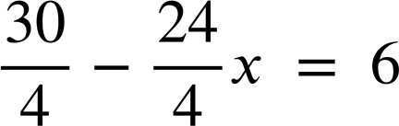
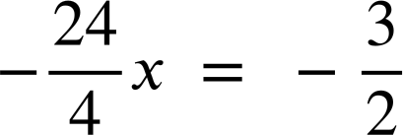
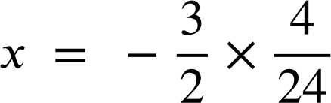
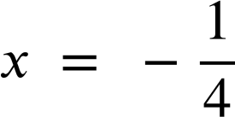
Checking and securing solving linear equations
Task A: Solving equations involving a bracketed expression
1) Spot the mistake in each method to solve an equation involving brackets.
a)
b)
c)
5(x + 10) | = | 55
5x + 10 | = | 55
5x | = | 45
x | = | 9
2(4x + 10) | = | 18
2x + 5 | = | 9
2x | = | 4
x | = | 2
7(x − 3) | = | 42
x − 3 | = | 6
x | = | 3
d)
e)
f)
(10 − 8x) | = | 6
5(3x + 2) | = | 14
8x + 10 | = | 14
8x | = | 4
x | = | 2
(2x − 5) | = | 15
2x − 5 | = | 3
2x | = | 8
x | = | 4

Slide 2
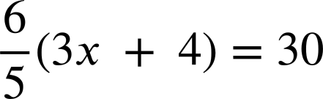
Checking and securing solving linear equations
2a) Solve this equation using both methods and write a sentence comparing the efficiency of the methods.
Expanding first:
Multiplying by the reciprocal first:
6(x − 9) | = | 21
6(x − 9) | = | 21
2b) Solve this equation using both methods and write a sentence comparing the efficiency of the methods.
Expanding first:
Multiplying by the reciprocal first:
15(4x + 7) | = | 45
15(4x + 7) | = | 45
2c) Solve this equation using both methods and write a sentence comparing the efficiency of the methods.
Expanding first:
Multiplying by the reciprocal first:

Slide 3
Checking and securing solving linear equations
Task B: Solving equations with multiple brackets
1) The solutions to the equations are given. Fill in the steps to show how to get to these answers. Other methods may also be valid.
a)
b)
c)
5(x + 6) | = | 7(9x − 4)
x | = | 1
2(4x − 5) | = | −6(3x − 7)
x | = | 2
8(x − 5) + 3(x + 5) | = | 8
x | = | 3
d)
e)
f)
4(3x − 1) − 2(3x − 1) | = | 22
x | = | 4
2(4x − 9) − 4(3 − 2x) | = | 50
x | = | 5
3(2(x + 4)+5) | = | 75
x | = | 6
2) Solve these equations twice. Firstly by expanding first, secondly by simplifying before expanding. Write a sentence to compare the efficiency.
a)
4(x + 5) + 3(x + 5) | = | 14
4(x + 5) + 3(x + 5) | = | 14
b)
21 + 3(2x − 3) | = | 7(2x − 3) − 3(2x − 3)
21 + 3(2x − 3) | = | 7(2x − 3) − 3(2x − 3)
Mathematics in Education and Industry
v2.3

